Slide 1
Numeric Representation
CS 160 – Exploring Computer Science
2002 - 2014
Jeff Abramson

Slide 2
Numeric representation
Bases:
2 BINARY 0, 1
8 OCTAL 0, 1, 2, 3, 4, 5, 6, 7
10 DECIMAL 0, 1, 2, 3, 4, 5, 6, 7, 8, 9
16 HEXADECIMAL 0, 1, 2, 3, 4, 5, 6, 7, 8, 9, A, B, C, D, E, F
EXAMPLE:
Decimal: 29
Binary: 011101 16 + 8 + 4 + 1 = 29
Hexadecimal: 1D (1 * 16) = 16 + “D” = 29
Octal: 35 (3 * 8) = 24 + 5 = 29
Notes:
using characters to represent numbers:
use the ASCII set to represent the number 123
0110001 0110010 0110011 ?? how many bits ??
base arithmetic:
position and powers
bases:
show conversion from binary to octal to decimal to hexadecimal and back again!
use binary to represent the number 123
111001 ?? how many bits ??
addition in binary:
demonstrate binary addition
fractions in binary:
go over radix notation and the fractional position values
1/2 1/4 1/8 etc.

Slide 3

Using different bases
Purpose:
To practice representing numbers in different bases
Time:
5 minutes
Agenda:
  Represent the following decimal integers in base 2, base 8, base 16:
  0, 1, 2, 5, 11, 15, 16, 35, 73

Slide 4
Adding in different bases…
Adding in different bases is the same process as adding in base 10, except that carries occur when the number matches the base value:
    01101 ( 13 ) 01110 ( 14 )
    +10010 ( 18 ) +01110 ( 14 )
    11111 ( 31 ) 11100 ( 28 )
₁
    0 1 1 1
    0 0 1 1 0 1 0 w/carry 1 w/carry

Slide 5
How many outfits?
If you possess 2 suits, 3 ties, and 4 pairs of shoes, how many different outfits do you have?
4 shoes
3 ties
4 shoes
4 shoes
2 suits
4 shoes
3 ties
4 shoes
4 shoes

Slide 6
Combinations
Purpose:
Use combinations to determine possibilities.
Who:
Groups of 2-3.
Time:
5 minutes
Agenda:
  Solve the problems on the following page:

Slide 7
If there are 4 different routes from Boston to Cincinnati, 3 routes from Cincinnati to Chicago, and 5 routes from Chicago to Denver, how many different routes are there from Boston to Denver that go through Cincinnati and Chicago?
In arranging your schedule for next term, you must select one humanities course, one social science course, and one math course. If there are 10 humanities courses, 7 social science courses, and 3 math courses, from how many different possible schedules could you select?
You want to make a string bead necklace. You have 3 different colors of beads and the necklace is 5 beads in length. How many distinct necklaces can you make?
In a large ballroom, there are a bank of light switches that control sections of lights in the room. There are 12 switches. How many different lighting patterns are there for the room?

Slide 8
Combinatorics on the computer
Suppose you have an 8-bit byte. How many different bit patterns are possible?
Suppose you have a 32-bit address line. How many different memory locations could you access?
Suppose you invent a new 2-byte character code. How many different characters could you represent?
Suppose you need to represent true and false on the computer. How many bits are required?
Suppose you would like to display color images. How many bits are required to produce 16 colors? 256 colors?

Slide 9

Characters
Character codes have been invented to represent alphanumeric data on the computer.
ASCII (American Standard Code for Information Interchange) is a 7-bit code. Extended ASCII is an 8-bit code.
EBCDIC (Extended Binary Coded Decimal Interchange Code) is an 8-bit code.
Unicode is a set of 8-,16-,32-bit codes. Unicode is designed to work in an internationalized environment.
http://www.unicode.org/

Slide 10
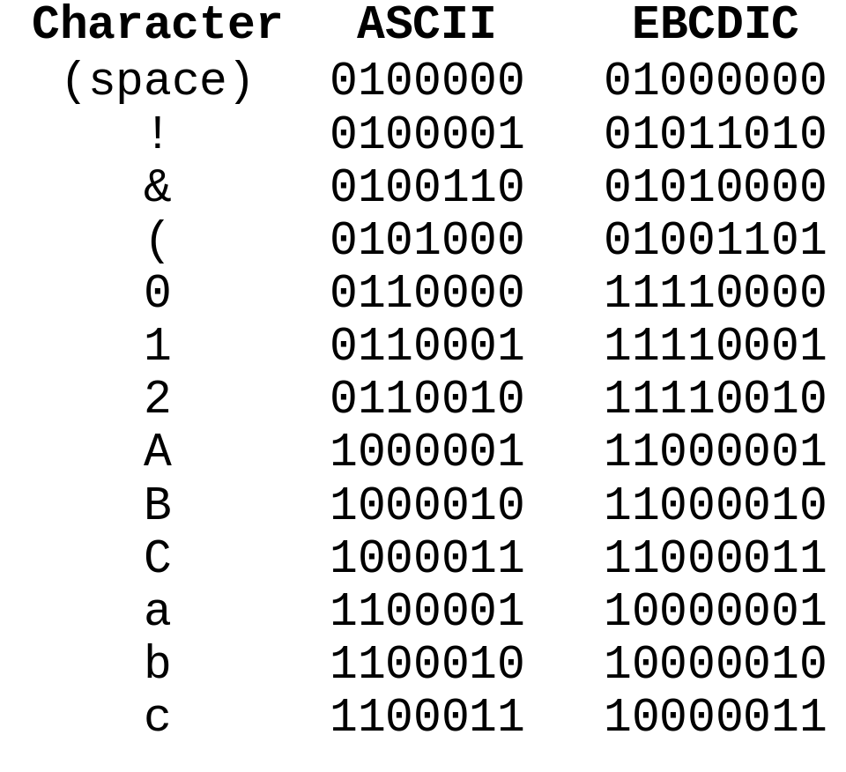
Comparison

Slide 11
Decode my message
Purpose:
Use ASCII to encode messages.
Who:
Individually.
Time:
5 minutes
Agenda:
  Write a movie title, song title or a book title (3-7 words). Encode your message in ASCII. Pass the message to a neighbor to decode. An ASCII chart is included on the handout.

Slide 12
Signed integers
Up until now, the integers you’ve seen in base 2 have been unsigned integers. There are some techniques for representing signed integers, that is, those that could be either positive or negative.
Techniques:
  Sign-magnitude
  1’s complement
  2’s complement
How many different signed integers could be represented using 3 bits?

Slide 13
Sign magnitude
Assume that you have 3-bits available to represent a signed integer. Reserve the first bit for indicating the sign and the other two bits represent the magnitude of the number (absolute value).
_____ _____ _____
magnitude bits:
represent the absolute value of the number
sign bit:
0 is +
1 is -

Slide 14
Range of values
How many values can you represent in 2-bits?
What is the range of values of sign-magnitude representation?
What do the following sequences mean?
    000
    100

Slide 15
A new subtraction
Suppose you wanted to subtract in base 10, but didn’t like to borrow…use 9’s complement.
Given a problem such as 632 – 498, you could use the following technique:
    ( 999 + 1 – 1000 ) + 632 – 498
    ( 999 – 498 ) + 632 + 1 – 1000
    ( 501 ) + 632 + 1 – 1000
    1133 + 1 – 1000
    1134 – 1000
    134!!!
What if the problem was 85342 – 38697? What would you do?

Slide 16
Using 9’s complement
Purpose:
Practice with 9’s complement.
Who:
Individually.
Time:
5 minutes
Agenda:
  Do a 9’s complement subtraction of the following:
      912 675
      -789 -598

Slide 17
Uh oh…
What if you try a 9’s complement and you get a negative answer?
    234 - 598
    ( 999 + 1 – 1000 ) + 234 – 598
    ( 999 – 598) + 234 + 1 – 1000
    ( 401 ) + 234 + 1 – 1000
    635 + 1 – 1000
    636 – 1000
    -364!!! but you must do a lot of borrowing!
You can get the right answer by doing 9’s complement again and adding 1 and adding a negation:
    999 – 636 + 1 = 363 + 1 = 364 => -364

Slide 18
Using 9’s complement
Purpose:
Practice with 9’s complement.
Who:
Individually.
Time:
5 minutes
Agenda:
  Do a 9’s complement subtraction of the following:
      333 149
      -789 -598

Slide 19
10’s complement
Another possibility is:
    ( 999 + 1 – 1000 ) + 632 – 498
    ( 999 – 498 + 1 ) + 632 – 1000
    ( 502 ) + 632 – 1000
    1134 – 1000
    134!!!
The number created by subtracting from 999 and adding 1 is called the 10’s complement.

Slide 20
1’s complement
In base 2, the 1’s complement of a number is formed by subtracting from the representation with all 1’s:
    0110101 (decimal value of 53)
    1111111
    -0110101
    1001010 ( -53 )
Do you notice anything about the pattern of the result?
To complement a bit is to reverse from a 1 to a 0 or vice versa.

Slide 21
2’s complement
The same as 10’s complement, add 1 to the 1’s complement representation:
    0110101 (decimal value of 53)
    1111111
    -0110101
    1001010
    + 1
    1001011 ( -53 )
Notice that the first bit in 2’s complement is essentially a sign bit: if it is 0, the number is positive, if it is 1, the number is negative.

Slide 22
How can you know the value?
If you have a negative number in 2’s complement, how can you determine its value? By complementing and adding 1!
    1001011 ( -?? )
complements to…
    0110100
    + 1
    0110101 ( 53 )
    Thus 1001011 is -53

Slide 23
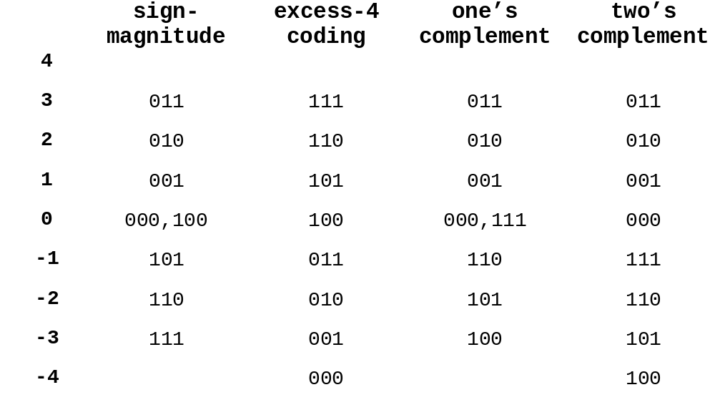
Signed integer representation
Notes:
--> integers require both positive and negative values!
sign magnitude
sign bit - magnitude (positive)
hw math (SUBTRACTION) in hardware with sign magnitude is difficult
+ and - 0 ??? WHY a problem???
excess coding
lay the bit patterns out in order and select the middle (median) element to be zero
then you'll notice that the binary value is greater than the true value by a fixed excess
111 3 "excess 4 coding" the 1000... pattern is always zero
110 2
101 1
100 0 true 0 not all 0's
011 -1
010 -2
001 -3
000 -4
one's complement
to get negative representation, just complement each digit --- SHOW EXAMPLES
still + and - 0
two's complement
most common representation
positive -> negative: take 1's complement and add 1!! (ignore carry out of sign bit)
negative -> positive: take 1’s complement and add 1!!
SUBTRACTION can be done in HW by doing the logical complement, add 1, then ADD
only one representation of 0!!! by all 000's
range is [- pow (2,# bits - 1) .... (pow (2, # bits - 1) - 1)]

Slide 24
What happens?
In 2’s complement:
What if you try to create –0?
What is the pattern of the largest negative number in 2’s complement? Is there a corresponding positive value?
What if you try to take the negation of the largest negative value in 2’s complement?
What happens if you add 1 to the largest positive number?
What happens if you subtract 1 from the largest negative number?

Slide 25
Overflow
Overflow occurs when the number is too large in magnitude to represent.
What is the largest possible positive number you can represent using 2’s complement and 8 bits?
What is the largest magnitude negative number you can represent using 2’s complement and 8 bits?

Slide 26
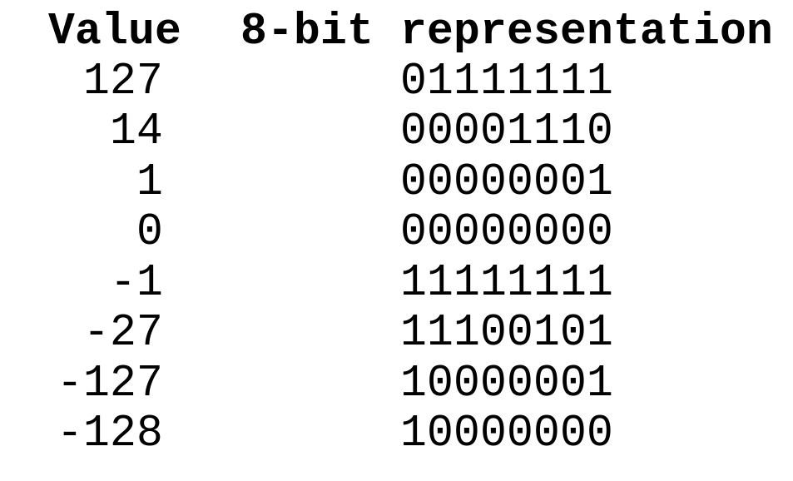
2's complement
14 + (-27)
00001110 (14)
11100101 (-27)
--------
11110011 (-13)
14 - 5
00000101 (5)
11111010
11111011 (-5)
00001110 (14)
11111011 (-5)
--------
00001001 (9)
Notes:
two's complement
encode (8 bit bytes):
-27 --> 00011011 --> 11100100 --> 11100101
14 --> 00001110
127 --> 01111111
0 --> 00000000
-127 --> 01111111 --> 10000000 --> 10000001
-128 --> 10000000 --> 01111111 --> 10000000
overflow in two’s complement
do 123 + 7 to show overflow!!!
01111011
00000111
--------
10000010
detected if the sum of two positive numbers is negative or the sum of two negatives
is positive!!!

Slide 27
2's complement overflow
102 + 57
01100110 (102)
00111001 ( 57)
--------
10011011 (?159)
-102 + -57
10011010 (-102)
11000111 (- 57)
--------
01100001 (?-159)
Notes:
two's complement
encode (8 bit bytes):
-27 --> 00011011 --> 11100100 --> 11100101
14 --> 00001110
127 --> 01111111
0 --> 00000000
-127 --> 01111111 --> 10000000 --> 10000001
-128 --> 10000000 --> 01111111 --> 10000000
overflow in two’s complement
do 123 + 7 to show overflow!!!
01111011
00000111
--------
10000010
detected if the sum of two positive numbers is negative or the sum of two negatives
is positive!!!

